Slide 1

Transition to Reception
Grove Lea Primary
“If it is to be, it is up to me!”

Slide 2
This meeting will hopefully provide you with an insight into our Reception Class and the opportunities and experiences that your child can look forward to. We are all extremely proud of our school and committed to providing the very best possible education for all of our children. We know that Grove Lea Primary is a school where:
School Rights
To keep ourselves and others Safe
To be Respectful
To come to school and Learn
Core Values- Also known as the 4C’s
Courageous
Curious
Caring
Collaborative

Slide 3
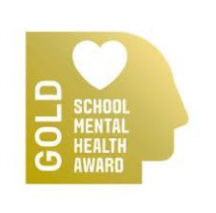
Mental Health and Well-being
The school worked in partnership with Leeds Beckett University towards the Mental Health and Well Being Award.
As part of the work we looked at improving the provision for students across school. Please follow the link below, which outlines how we embed Mental Health and Well Being throughout the curriculum, as well as the additional support we will offer for any children who may need it.
Mental Health & Wellbeing - Primary School - Grove Lea Primary School (ipmat.co.uk)

Slide 4
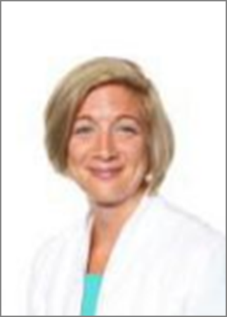


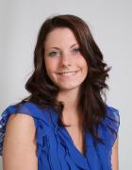
Meet the Team
Mrs Henshall
Executive Headteacher
(Safeguarding Lead)
Mrs Wilson
Head of School
Miss Litchfield
Learning Mentor
Mrs Dransfield
Special Needs Coordinator

Slide 5
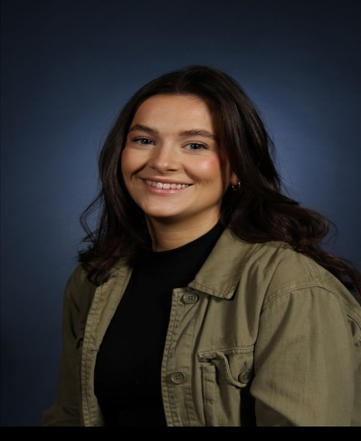
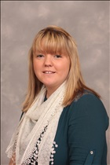
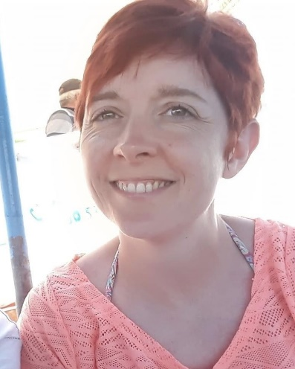
Reception Team:
Miss Smith
Reception Class Teacher
Mon-Wed
Mrs Wilson
Head of School
Nursery Teacher
EYFS Lead
Mrs Walker
Reception Class Teacher
Thur-Fri
Miss Hyde
Reception Class Teaching Assistant

Slide 6
The Curriculum
We follow the Development Matters Early Years Foundation Stage Curriculum
This curriculum is delivered through play with each child’s interests and needs being at the centre of all our planning. Activities change weekly to support children’s learning around the theme of that week.
Knowledge Organisers which outline each terms learning are added to your child’s class Dojo page.
The staff will spend time observing your child to find out their needs and interests

Slide 7
Child Initiated Play
Carefully planned resources and activities are available in all areas of learning both indoors and outdoors for children to choose from.
Children are given time to access these resources freely which allows them to follow their own interests, build their skills in problem solving and develop their ideas at their own pace.

Slide 8


The adults role
To teach planned focussed session across all areas of learning.
Plan and teach small focus activities to enure and check learning.
Observe and support children in their play and learning both indoors and outdoors.
Assess and plan for next steps in learning.
Notes:
Parents will be asked to fill out a questionnaire about their childs interests to help us with a starting point. We value contributions from parents about what their child achieves at home.

Slide 9
We encourage independence
We encourage children to:
Come into class leaving parents and carers at the door.
Take off and put on their own coat
Put away lunch boxes, water bottles and reading folders
Change their own shoes
Use the toilet and wash hands independently
Become more independent in play and accessing activities.
Take turns and share.
Ask for help when they need it.
In your packs you will find a readiness checklist to support your child in preparing for starting Reception.

Slide 10
Areas of learning in the early years:
Your child will be learning skills, acquiring new knowledge and demonstrating their understanding through 7 areas of learning and development.
Children should mostly develop the 3 prime areas first. These are:
Communication and language, Physical development and Personal, social and emotional development.
These prime areas are those most essential for your child’s healthy development and future learning.
As children grow, the prime areas will help them to develop skills in 4 specific areas. These are:
Literacy, Mathematics, Understanding the world and Expressive arts and design.
Over the next few slides you will see what this looks like in the Early Years setting.

Slide 11

Learning in the Early Years

Slide 12
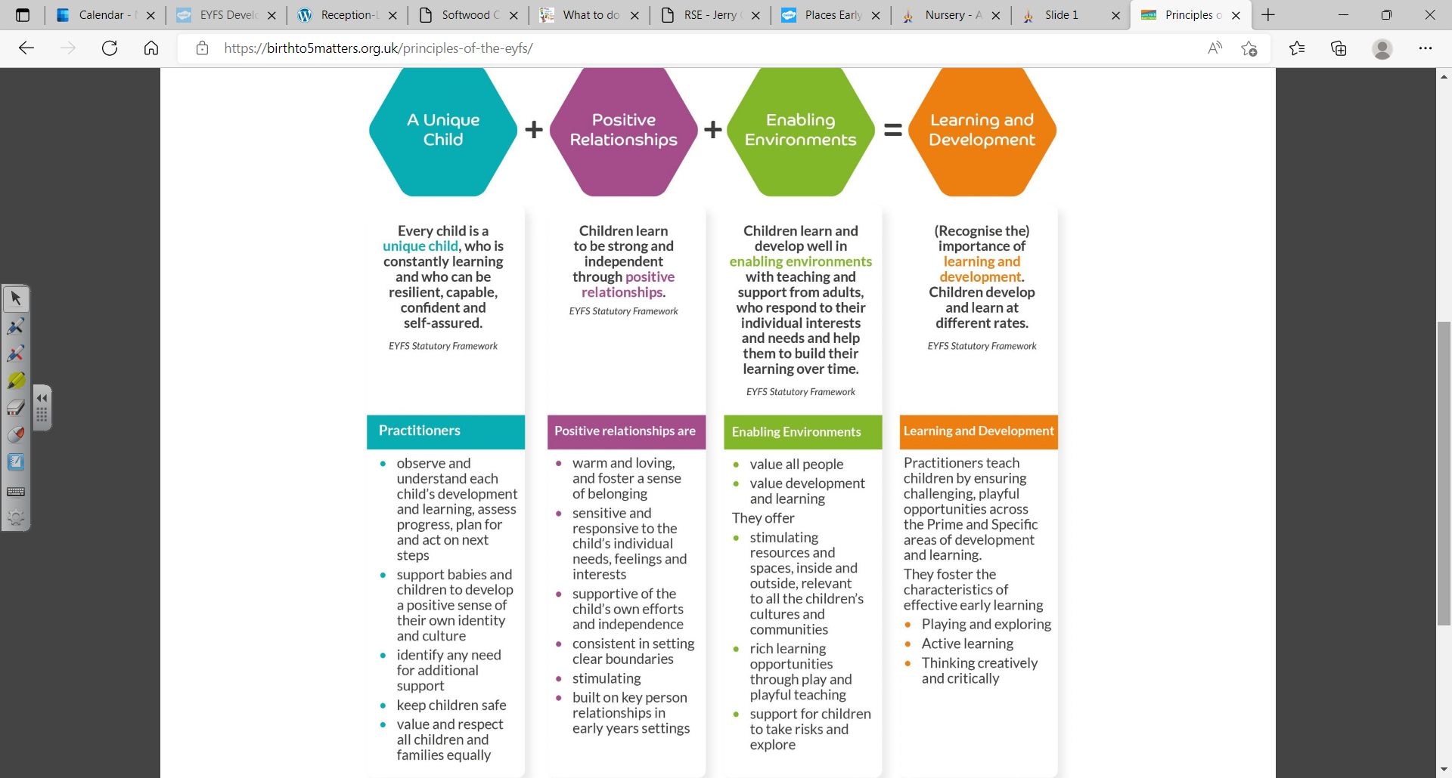

Slide 13
Your child will be learning skills, acquiring new knowledge and demonstrating their understanding through 7 areas of learning and development.
3 Prime areas-Communication and language, Physical development and Personal, social and emotional development.
As children grow, the prime areas will help them to develop skills in 4 specific areas. These are:
Literacy, Mathematics, Understanding the world and Expressive arts and design.
Over the next few slides you will see what this looks like in the our setting.

Slide 14
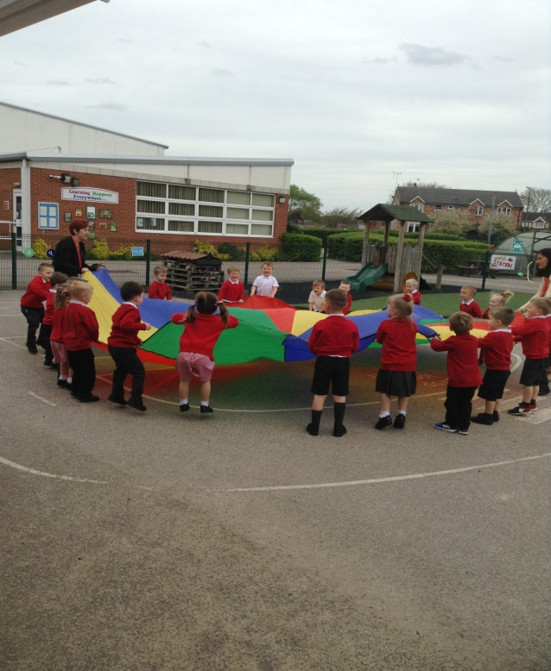
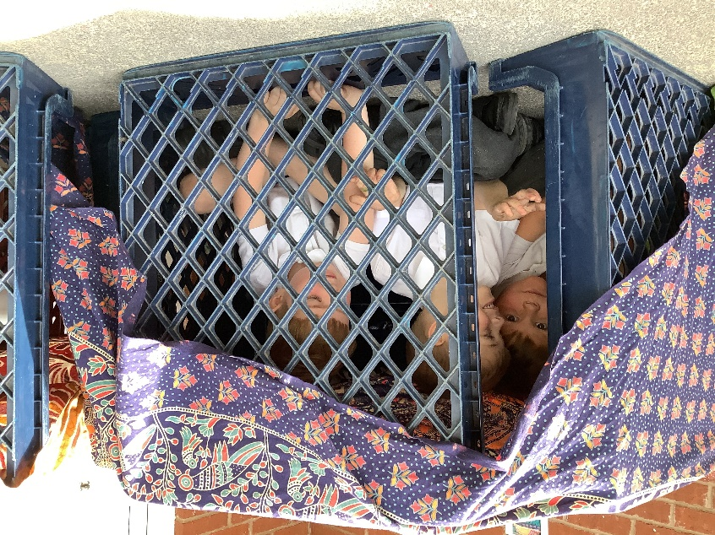
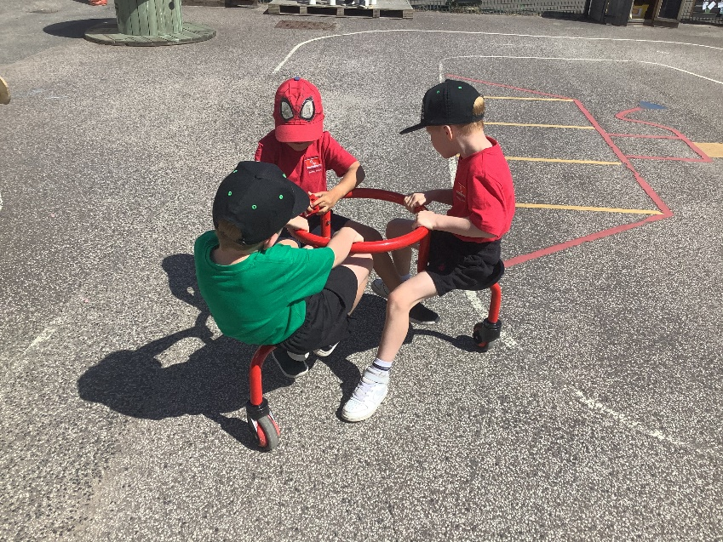
Personal, Social,
Emotional Development
Self Regulation
Managing
Self
Managing
Feelings
Building
Relationships

Slide 15
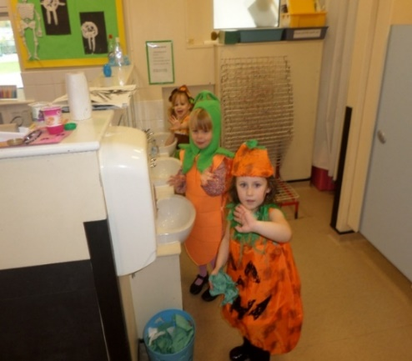
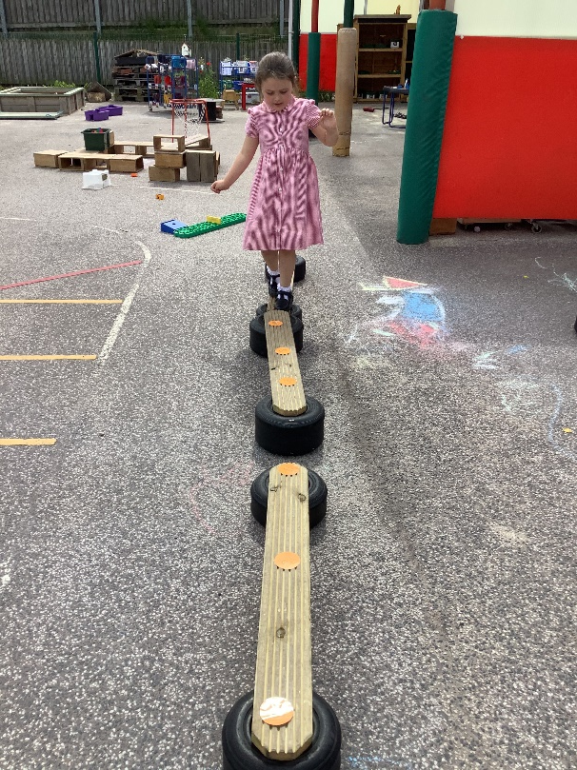
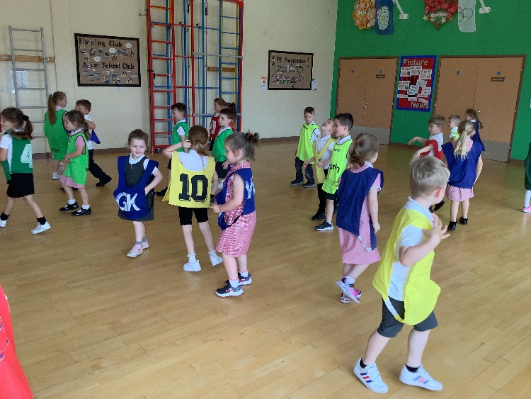
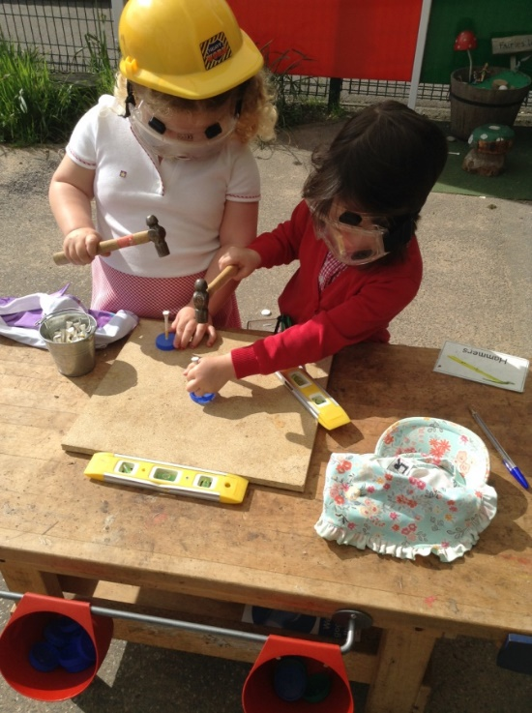
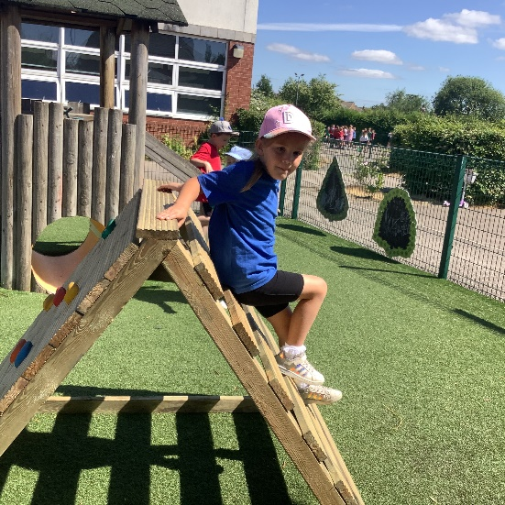
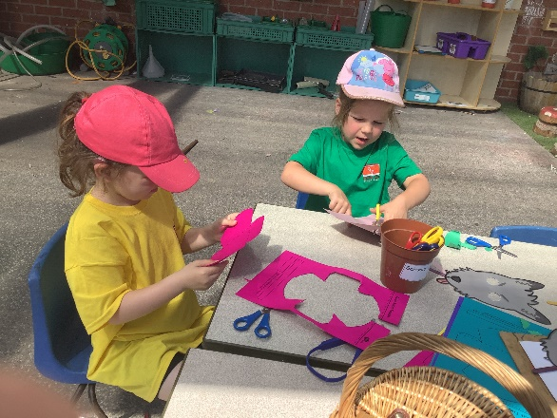
Physical
Development
Fine Motor
Gross Motor

Slide 16
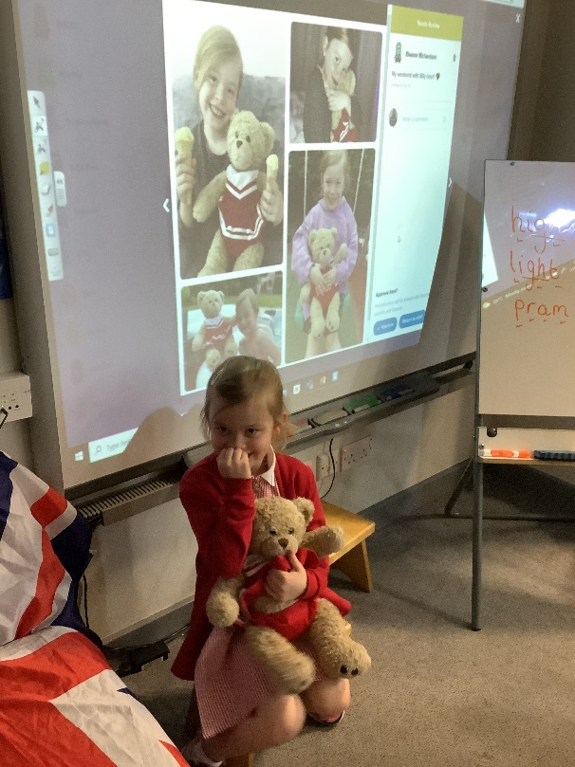
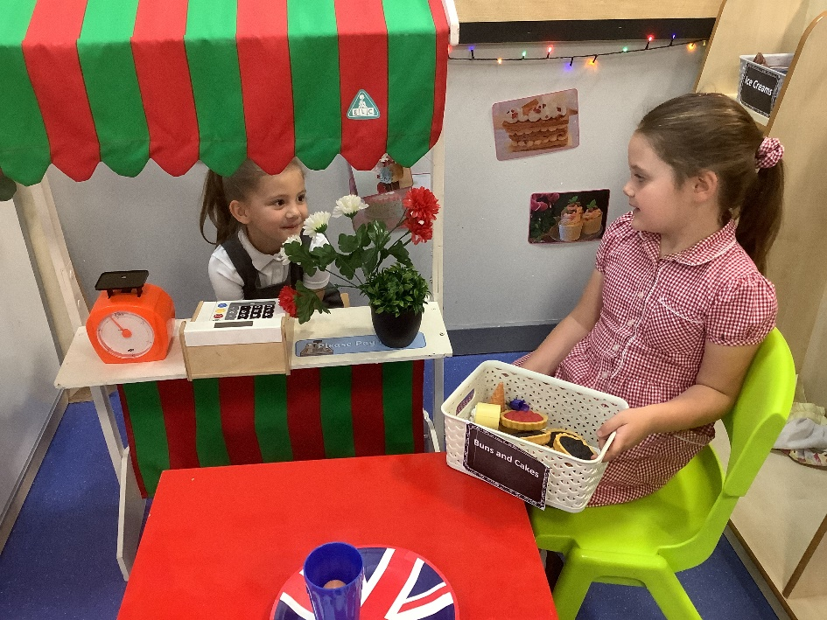
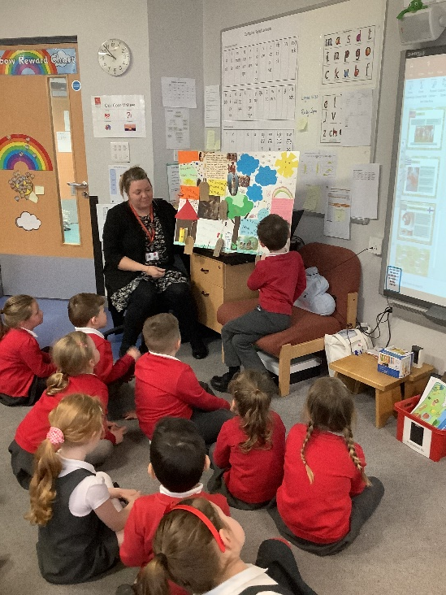
Communication
and Language
Speaking
Listening and Attention
Listening, attention and Understanding

Slide 17
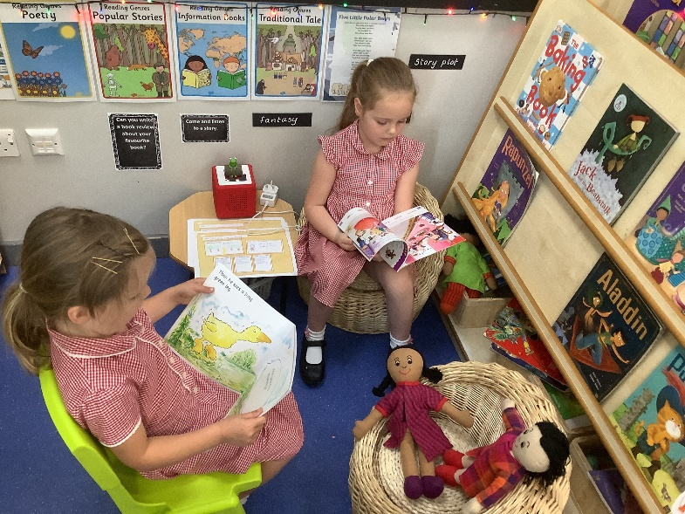
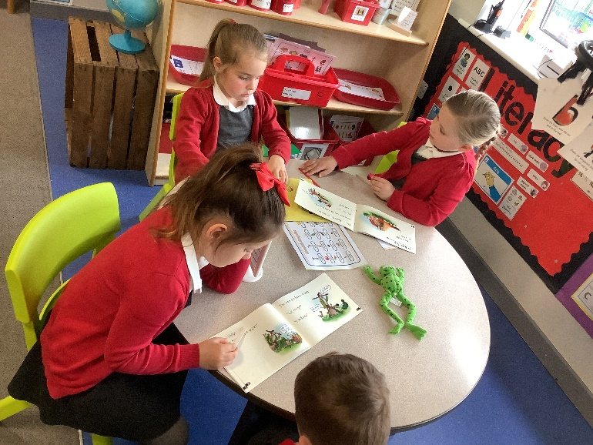
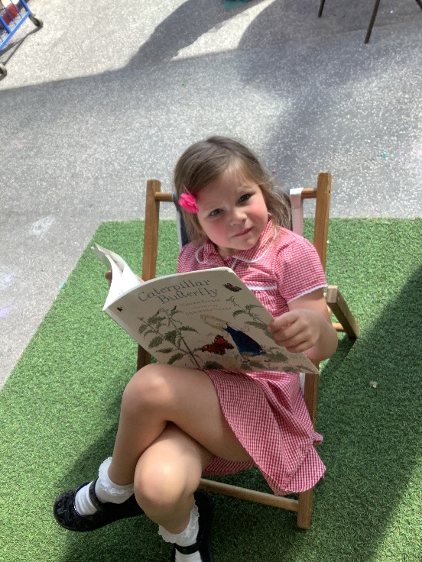
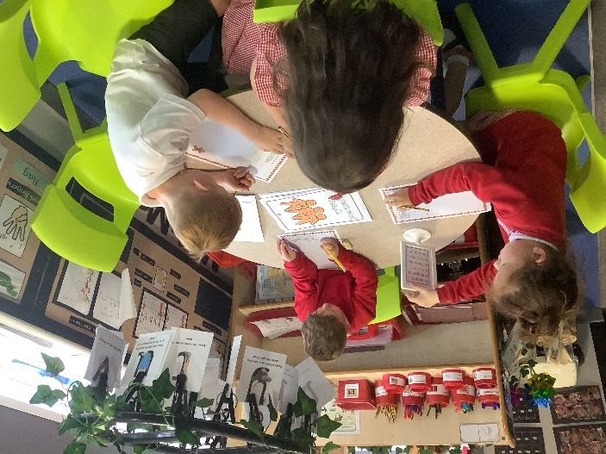
Literacy
Writing
Reading
Writing
Comprehension Word reading
Notes:
Use of phonics

Slide 18
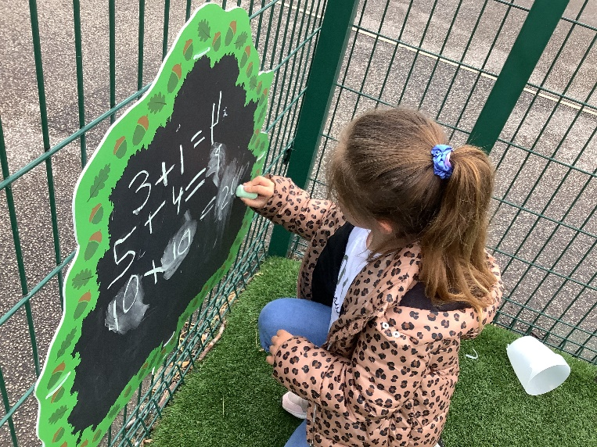
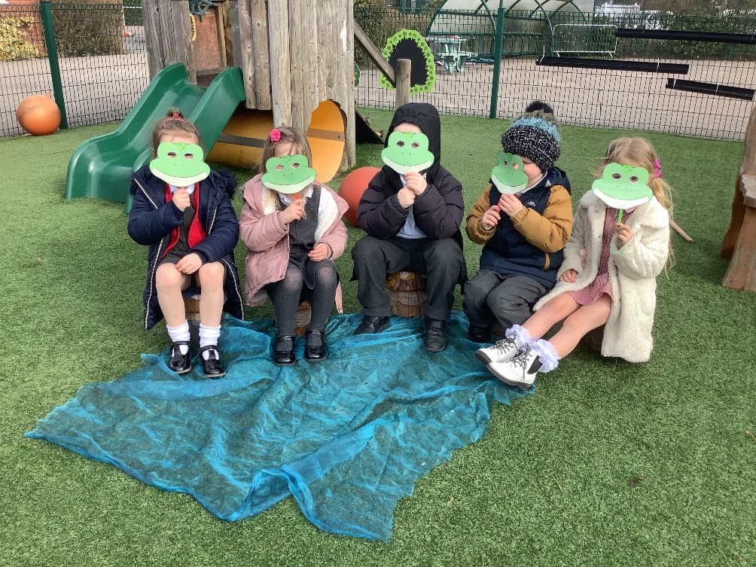
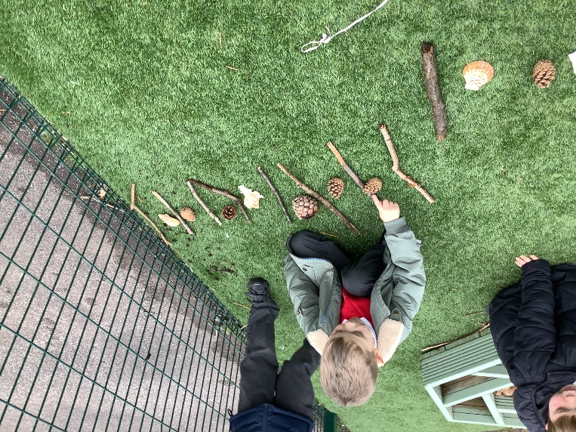
Mathematics
Number
Number
Numerical patterns

Slide 19
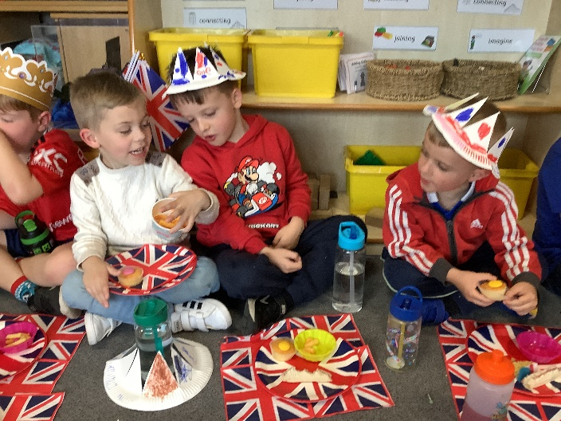
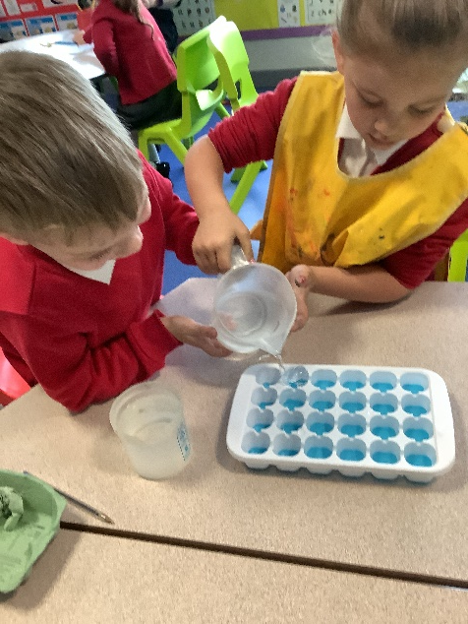
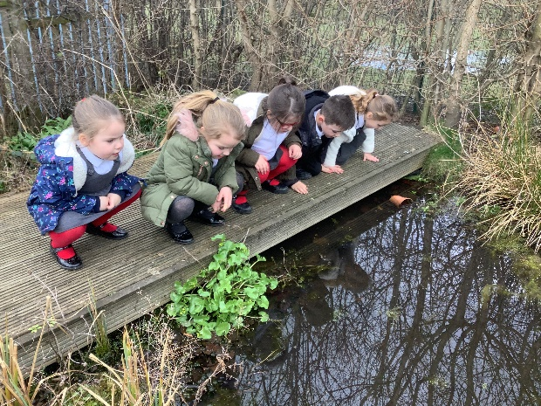
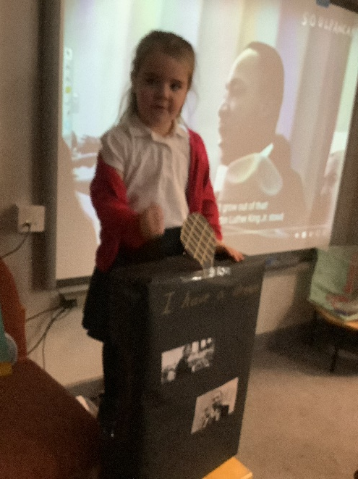
Understanding
the World
People,
Culture and Communities
Past and Present
The Natural World

Slide 20
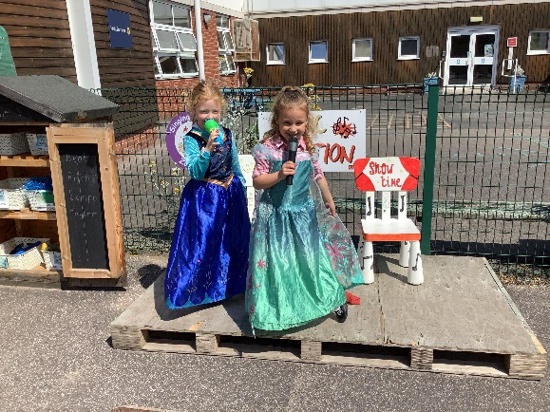
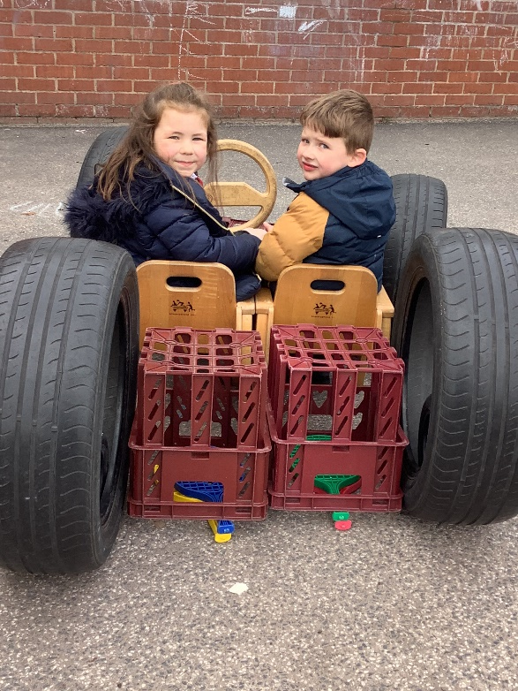
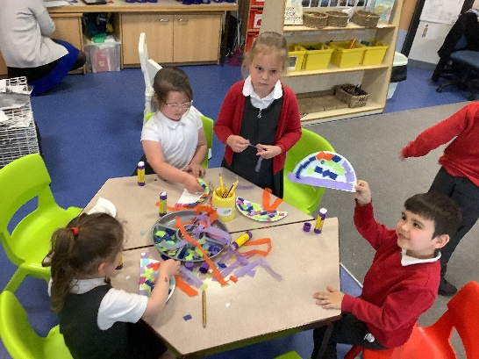
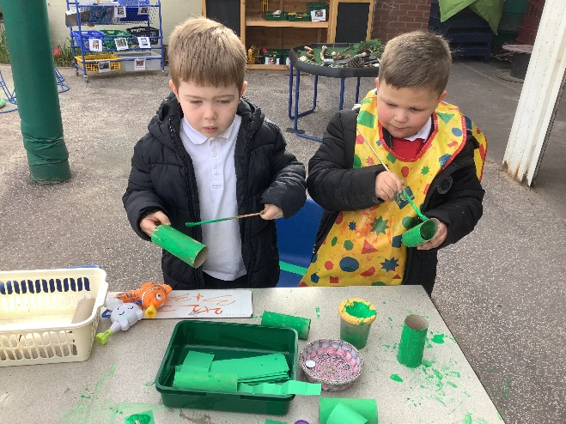
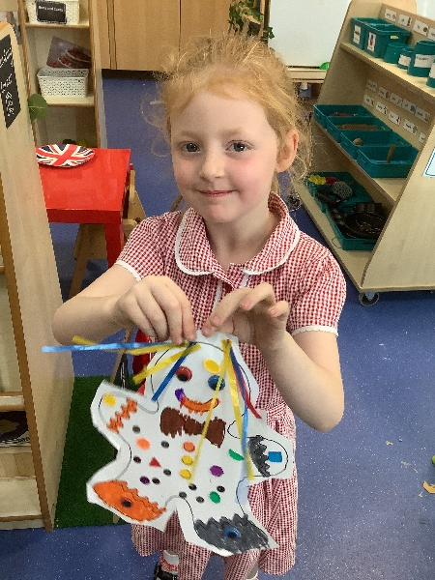
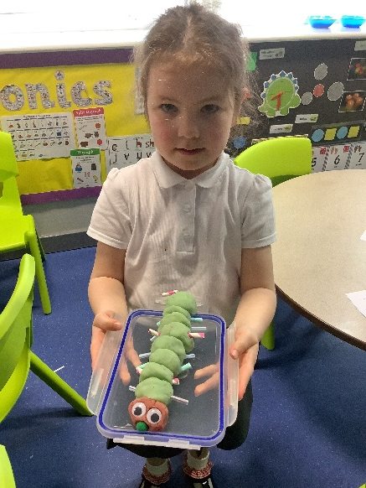
Expressive Arts and Design
Being Imaginative and expressive
Creating with materials

Slide 21
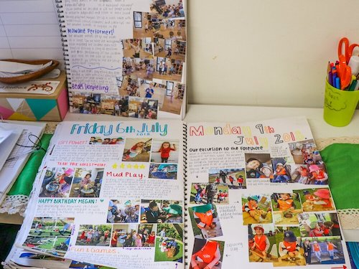
Floor Books
In each area of learning we have floor books. We use these to capture learning.
This might be something your child says to explain their knowledge and understanding or examples of things they have created.
Photographs of your children playing and learning.
A sample of these will also be taken and added for you to see on our class Dojo page.
We also use seesaw to record children’s learning and attainment.
In addition to this your child will also have a literacy, Read, Write, Inc book and a maths book to record weekly and daily learning.

Slide 22

Reading – Read Write Inc.
All children take part in a RWI session every morning focusing on supporting their sound recognition, reading and writing skills.
All children will be given either a letter sounds sheet, a Ditty sheet to begin with, this then progresses as they develop their reading skills.
All reading sheets/ books and reading recordings MUST be brought to school every day, as their no set day for sheets/books to be changed. This will depend upon the group your child is in and their readiness.
To support your child at home we kindly ask for you to read at least 3 times per week. In addition to this their will be an online speed sounds link which the children will be familiar with from their lesson. You can find this every Friday on class story Dojo.
For more information about RWI please visit https://www.ruthmiskin.com/parents/
Notes:
Share ditty book and sheet

Slide 23
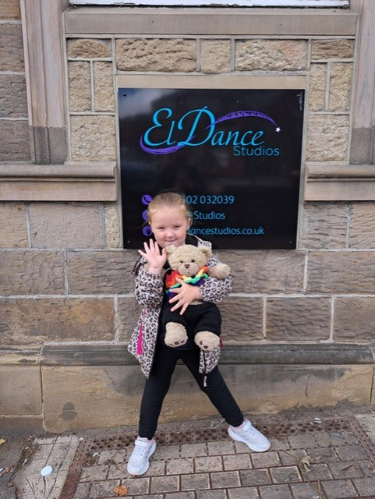
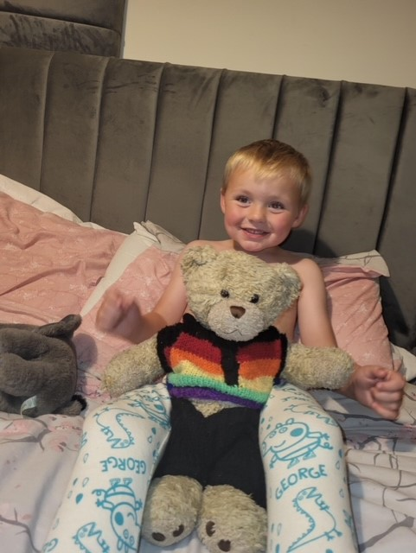
Billy Bear
Our lovely class Bear Billy likes to join your children on a weekend. We appreciate photographs and news to share.

Slide 24

Library
Reception visit the library once every half term.
During this time a story is shared with the children and they will have the opportunity to choose a book to take home.
We hope you will be able to join us.

Slide 25
Session Times
Reception sessions are 8.50am -3.20pm.
Children come into Reception independently, complete self registration tasks, join in with wake up shake ups and settle ready for the register and RWI.
Collection Arrangement
We appreciate if you could drop off and pick up as promptly as possible and ask that you do not enter the classroom. If you arrive late, children will need to be dropped off/collected from the main office door.
At the end of the session we will only allow your child to be collected by people that you have authorised to do so (password)
Please make sure we are notified of any changes.
Notes:
25

Slide 26
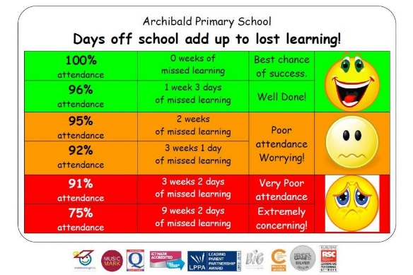
Attendance
It is important that children attend school
everyday to avoid lost learning.
Holidays are not authorised during term
time.
If 5 consecutive days are missed, you will be required to attend a meeting with the headteacher.
It is really important that you contact us using the school number (01977 615080) if your child is unable to attend a session. Please ring before the session starts. If we do not hear from you a member of the team will contact you to ask for a reason for absence.

Slide 27
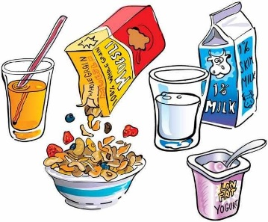
Morning Club
Morning club runs from 7:45am every morning and is available for all children in reception.
Drop off is at the family learning room at the side of the main entrance to school.
Places can be booked through the school portal scopay (you will be set up on this system and sent a link to book when your child begins reception class).
Cost is at £3 per session (free for children eligible for pupil premium free school meals).
Children are offered breakfast including cereal and toast and milk or water.
Children are provided with games and other activities such as dance and music.
Children are then brought down to classrooms ready for the register.

Slide 28

A little extra . . .
A variety of after school clubs will be offered, these are in 10 week blocks and cost £20. These finish at 4:30pm and you will collect your child from the main office reception.
These can be booked via our sopay app.

Slide 29
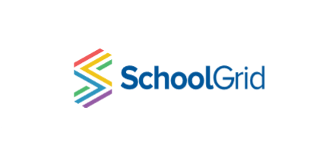
School meals
All children are entitled to free school meals however, you are more than welcome to bring a packed lunch. No nuts, sweets or glass please.
School meals must be booked in advance at home with your child using a link which will be shared with you, as soon as it is set up.

Slide 30
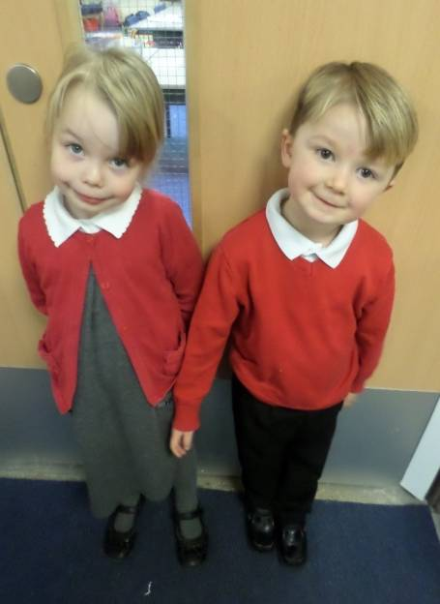
School Uniform
School uniform (information is on our website)
Please label all items of clothing (even shoes)
Our logo is available through Tesco Uniform
(myclothing.com).
Clothing
Plain grey or black school skirt or trousers.
Red and white checked dress or plain grey or black knee length tailored shorts in summer.
White school blouse or polo shirt.
Berry red cardigan or sweatshirt.
White, black, red or grey socks/tights.
Headbands, slides & bobbles in school colours (red/white/grey/black)
Plain black shoes or black trainers with no logos. No flashing lights please. If children come to school in boots or wellingtons, they will need to bring their shoes to change in to.
Velcro shoes are easier to support independence as the children change into wellies for the outdoor / sand area at times.
We do ask for a spare bag of clothes to be brought daily to the session. Just in case. We do also ask children to bring a pair of wellington boots with their name in to leave at school, as we do access the outdoor environment in all weather (we provide puddle suits). Jewellery is not permitted other than watches and one pair of small gold or silver stud ear-rings.
Notes:
30

Slide 31
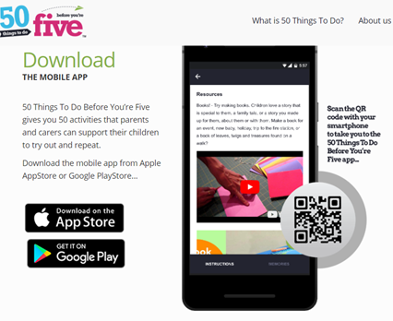

50 things to do before you’re 5!
The 50 Things To Do Before You’re Five mobile app gives parents and carers 50 low or no-cost experiences to support their child's social, emotional, physical and early language development.
The app contains all the information, guidance and supporting resources to allow parents to build a memory bank of photos and videos, as a collection of their child's special moments.

Slide 32
Contact numbers
Please inform us of any changes to information especially phone numbers. We also require at least 2 emergency contact numbers please.

Slide 33
Medical Needs
Dietary/Medical Requirements:
Please ensure we are informed of
any special dietary requirements, food
allergies or medical needs
Inhalers-
If your child requires an inhaler we do need an inhaler that we can keep at school at all times, should they require it.

Slide 34
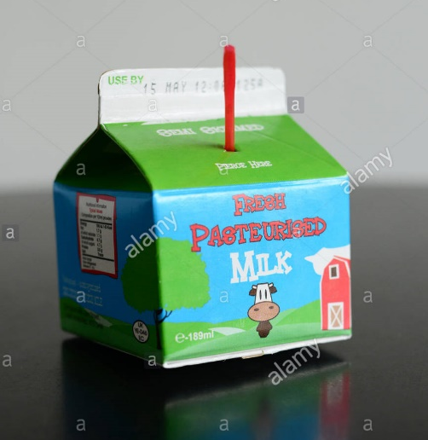
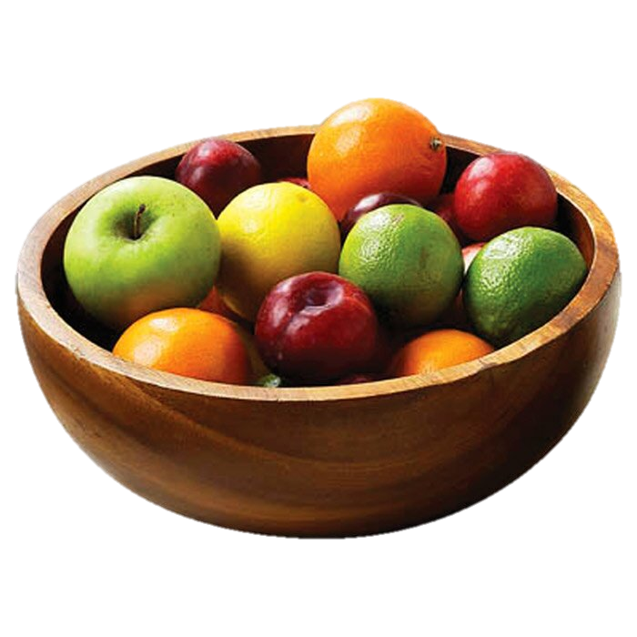
Snack
50p each week
for
Snack
Collected on a
Monday
We do ask for weekly donations of 50p. This covers daily snacks and other events we hold.
Your child will be given a free carton of milk during the session, until the term in which they turn 5 years of age.

Slide 35



Behaviour
Within Reception, the children are
praised for good behaviour using
many different types of rewards.
Weekly:
Star of the week
Dojo winner - child who has been rewarded with the most dojo points.
Helping hands - children are given responsibilities within the classroom, such as tidy up monitor.
Dip in the box – Completion of all challenges.
Daily:
Stickers
Dojo points
Calm Zone
We have a calm zone where children will go and have some time out and to help regulate their emotions.

Slide 36
Parental involvement
Our aim at Reception is to work in partnership with you. We have a variety of ways in Reception that we can do this:
- Library visits
- Creative events in school
- Parent consultation evening
- Dojo
- Busy bags / story sack lending service
- Caring for our class bear on a weekend
Notes:
36

Slide 37
How to help…
Playing games that involve taking turns and sharing.
Sharing stories and talking about characters and what happened.
Sing songs and nursery rhymes.
Learning letter sounds.
Recognising their name.
Writing their name.
Fred talk
Counting objects.
Singing counting songs and rhymes.
Encouraging imaginative play.
Listening to your child read.
Please look at out knowledge organisers on Dojo and support with learning opportunities at home.

Slide 38
Web Links
School Website
http://www.grovelea.ipmat.co.uk
Dojo:
https://www.classdojo.com
School Dinners:
Link to follow
Twitter
https://twitter.com/ipmatgrovelea?lang=en

Slide 39
We look forward to seeing you, when you start with us on Tuesday 3rd September.

Slide 40
Questions
Please send all questions you may have via a dojo message. We will answer these and post on dojo in case anyone else wanted this question answering or may find it useful.
Thank you

